Slide 1

Operating system

Slide 2
Outline
Advanced Scheduling Algorithm: Highest response ration next, Lottery scheduling
Multilevel Queue Scheduling
Multilevel Feedback Queue

Slide 3
Lottery scheduling
Random, uniform way to allocate resources
In this scheduling:
Every process have some tickets
Scheduler picks a random ticket
Process having that ticket wins and assigned the CPU
It then execute for a time slice
And then another ticket is picked by the scheduler.
These tickets represent the share of processes. A process having a higher number of tickets give it more chance to get chosen for execution.

Slide 4
Lottery scheduling: Example
Consider two processes A and B having 30 and 70 tickets respectively out of total 100 tickets. CPU share of A is 30% and that of B is 70%. These shares are calculated probabilistically and not deterministically.
Explanation –
A has 30 tickets (ticket number 1 to 30) and B has 70 tickets (ticket no. 31 to 100).
Scheduler picks a random number from 1 to 100. If the picked no. is from 1 to 30 then A is executed otherwise B is executed.
An example of 10 tickets picked by Scheduler may look like this – 73 82 23 45 32 87 49 39 12 31
Resulting Schedule - B B A B B B B B A B

Slide 5
Lottery scheduling: Example
A is executed 2 times and B is executed 8 times. (A: 20% of CPU and B: 80%)
But in a long run (i.e., when no. of tickets picked is more than 100 or 1000) we can achieve a share percentage of approx. 30 and 70 for A and B respectively.
Advantage:
It also solves the problem of starvation.
Giving each process at least one lottery ticket guarantees that it has non-zero probability of being selected at each scheduling operation.

Slide 6
Highest response ratio next (HRRN)
Non-preemptive scheduling algorithm: Once a process is selected for execution will run until its completion
Modification of Shortest Job Next (SJN) in order to reduce the problem of starvation.
In the HRRN scheduling algorithm, the CPU is assigned to the next process that has the highest response ratio and not to the process having less burst time.
Response Ratio = (W+S)/S
Where, W = Waiting Time, S = Burst Time

Slide 7
Highest response ratio next (HRRN)
Steps:
Calculate the waiting time for all the processes. Waiting time simply means the sum of the time spent waiting in the ready queue by processes.
Processes get scheduled each time for execution in order to find the response ratio for each available process.
Then after the process having the highest response ratio is executed first by the processor.
In a case, if two processes have the same response ratio then the tie is broken by using the FCFS scheduling algorithm.

Slide 8
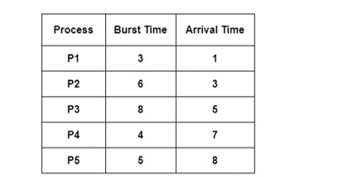
HRRN: example

Slide 9
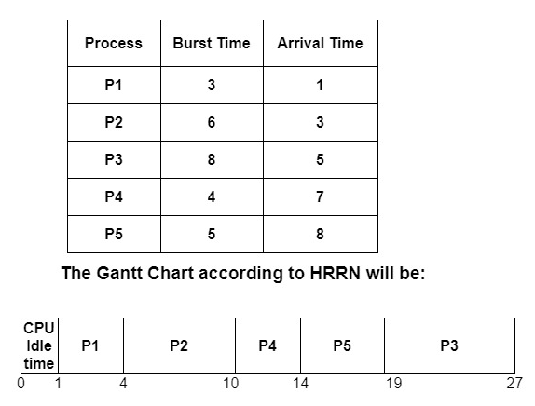
HRRN: example
At t = 0, no process is available in the ready queue,
therefore, CPU is idle for t = 0 to 1
At t = 1, only P1 is available, therefore it is executed till completion
At t = 4, only P2 has arrived, so P2 is executed till completion
At t = 10, there is P3, P4, and P5 in the ready queue, so in order to
schedule the next process, we need to compute the response ratio:
P3 = ((10-5)+8) / 8 = 1.625
P4 = ((10-7) +4) / 4 = 1.75
P5 = ((10-8) +5) / 5 = 1.4
Since P4 has the highest response ratio, so P4 is executed next.
At t = 14, compute the response ratio of P3 and P5: P3 = ((14-5) +8) / 8 = 2.125
P5 = ((14-8) +5) / 5 = 2.2
So P5 is executed next followed by P3

Slide 10
Highest response ratio next (HRRN)
Advantages
Gives better performance than the shortest job first Scheduling.
There is a reduction in waiting time for longer jobs and also it encourages shorter jobs.
Throughput increases.
Disadvantages
Practical implementation of HRRN scheduling is not possible because we cannot know the burst time of every process in advance.
There may occur overhead on the processor.

Slide 12
Multilevel queue scheduling
Algo is suitable for processes that can be categorized into groups.
Here, ready queue is partitioned into multiple queues. For e.g.,
Foreground (Interactive)
Background (Batch)
Each queue follows its own scheduling algorithm

Slide 13
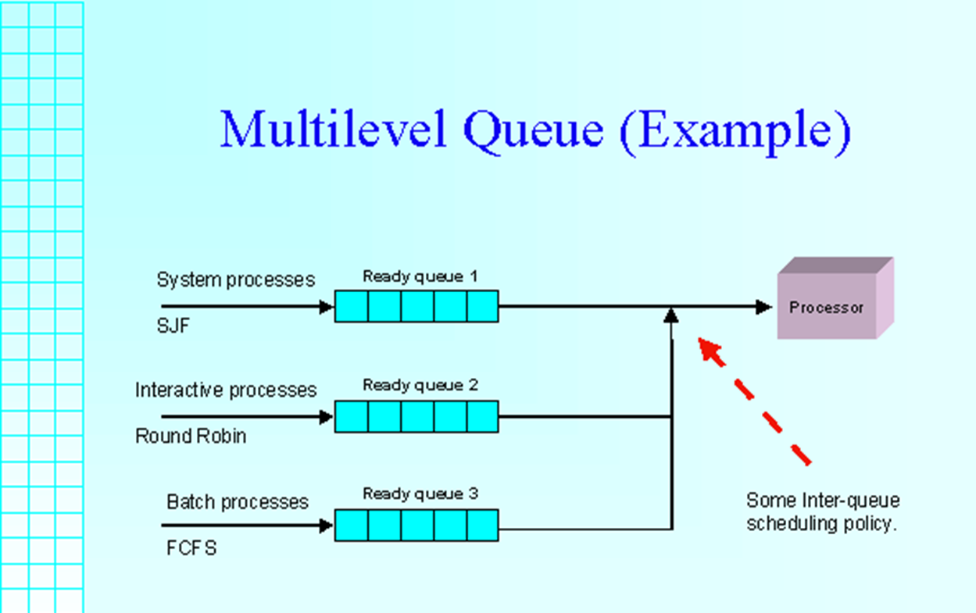
Multilevel queue scheduling
IMG SRC: https://slideplayer.com/slide/14919762/

Slide 14
Multilevel queue scheduling
Inter-queue scheduling is required.
For example:
fixed priority scheduling (lead to starvation)
Time slice for queues: 80% to interactive and 20% to batch

Slide 15
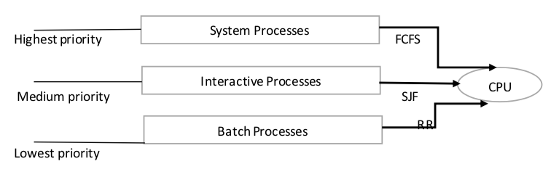
Multilevel queue scheduling
IMG SRC: https://tutorialwing.com/multilevel-queue-scheduling-tutorial-with-example/

Slide 16
Multilevel FEEDBACK queue scheduling
Usually, processes do not move between queues because of predefined priorities
Advantage: Low scheduling overhead
Disadvantage: Inflexible
Multilevel Feedback Scheduling allows a process to move between queues

Slide 17
Multilevel FEEDBACK queue scheduling
Multilevel Feedback Queue Scheduler is defined by following parameters:
Number of queues
Scheduling algo for each queue
Method to determine when to upgrade a process
Method to determine when to demote a process
Method to determine which queue a process will enter when that process needs service

Slide 18
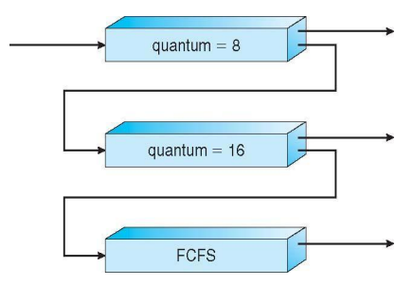
Multilevel FEEDBACK queue : Example
Three queues:
Q0 – RR with time quantum 8ms
Q1 – RR time quantum 16ms
Q2 – FCFS
Scheduling:
A new job enters queue Q0 which is served FCFS
When it gains CPU, job receives 8 milliseconds
If it does not finish in 8 milliseconds, job is moved to queue Q1
At Q1 job is again served FCFS and receives 16 additional milliseconds
If it still does not complete, it is preempted and moved to queue Q2
Aim: Preference given to short lived processes

Slide 19
Thank You

